Slide 1
A (brief) history of computing
By Dane Paschal
Notes:
It’s very brief, breadth is emphasized over depth and covers such things as the development of the theory of computer science, the breakthroughs in hardware, the evolution of programming, the internet, and famous figures, places, and causes thereof.

Slide 2
Biases
Amero-Euro centric
Computer science centric
Google centric
Notes:
I believe it is important in any teaching endeavor, but especially with history, to admit your basis of knowledge and possible biases to that your audience can better understand why you chose to include what you did and why you may have left out others. In this case, the history of computing is very euro-centric due to it’s growth in Europe and the USA and I have taken a Computer science centric approach, focusing on things that Computer scientists themselves find important.

Slide 3
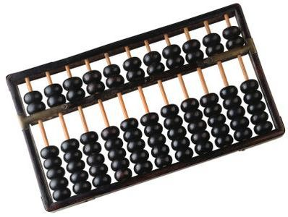
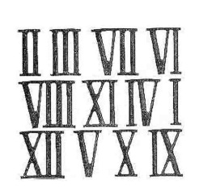
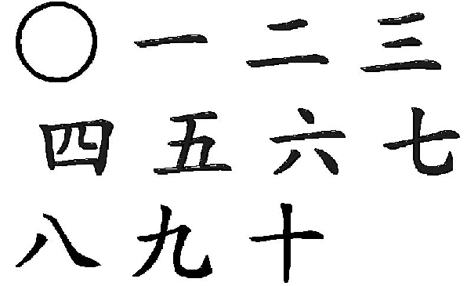
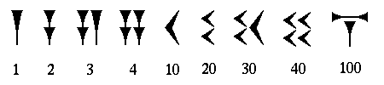
Ancient Origins
Counting is hard…
  The Human Brain
  Abacus
  Numerals

Slide 4
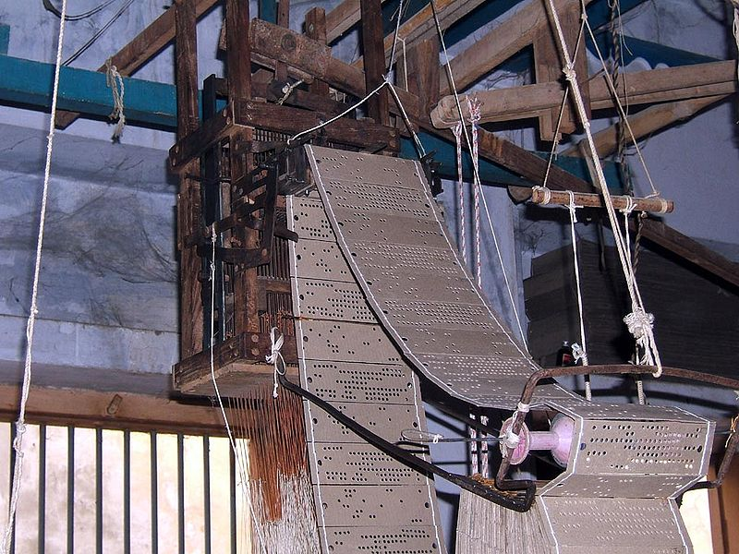

The 1700’s and 1800’s
Computing as a job
  Moved beyond governmental in a big way
  Industries now need large pools of computing power
  Scientific inquiry requires more brainpower and number crunching
Inventions
  Pascal’s wheel
  Slide rules
  Napeir’s bones
  Jacquard’s loom ← programmable!

Slide 5
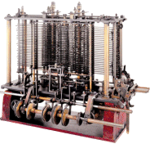
Babbage and Lovelace
Charles Babbage
  Math professor at Trinity College in Cambridge
  Difference engine
  Analytical engine
    Mill and store (cpu and memory)
Ada Augusta, Countess of Lovelace
  Amazing mathematician, helped Babbage
  “first programmer”
Notes:
Charles Babbage and Ada Lovelace together came upon the fundamentals of computing in the analytical engine. A machine that could be used to have multiple mathematical uses based upon the input (programming), had separate pieces for processing and storing, and gave output.
Babbage came up with the mechanics, Ada wrote about it’s potential for performing repetitions and decisions (control flow)

Slide 6
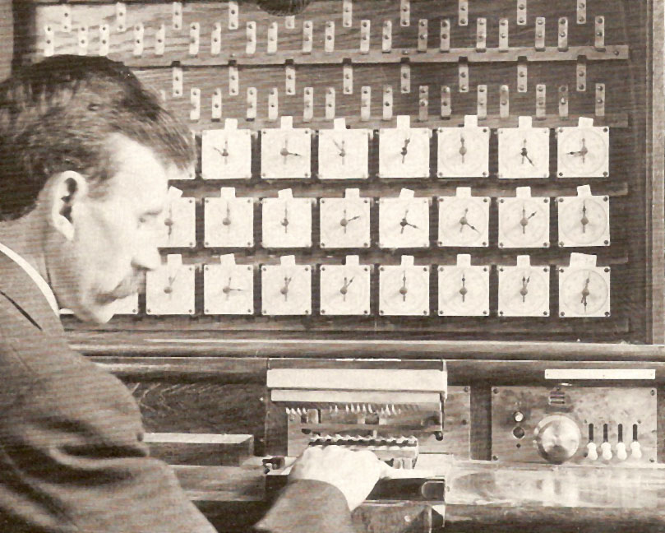
Hollerith and the Census
U.S. needed help with the 1890 census
  Dr. Herman Hollerith, statistician and inventor was hired to help
  Took punch cards from the Jacquard loom and turned it into a punch card database!
  Cut down the census tabulation by 6 years (from 8 to 2) saving millions
  Founds company that would become IBM
    Production of punch-card machines and
    mechanical calculators
Notes:
The census has a surprising history with computing, mostly because it requires a large amount of data to be processed in a short amount of time.

Slide 7
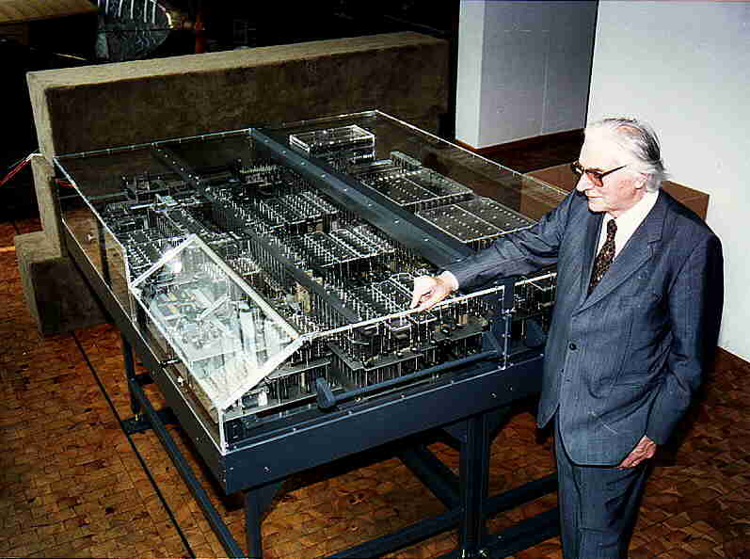
Electricity and Binary
Konrad Zuse
  Civil engineer
  “you can say I was too lazy to calculate so I invented the computer”
  Created the Z1 using binary and electrical circuits
  Drafted into German military for WWII, but was soon hired to build the Z2
  Saw the use of vacuum tubes for faster computing, but calculated it would take too long to implement.
Notes:
A major breakthrough, the use of binary arithmetic as opposed to base ten made electronic computing a reality.

Slide 8
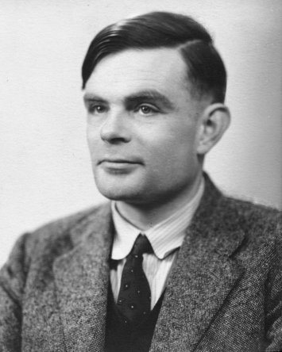
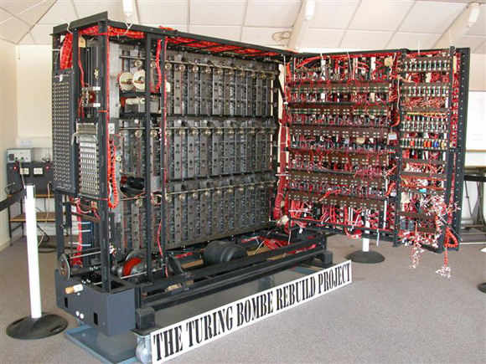
Learning to love the Bombe
Alan Turing
  Hired by England to crack codes set by the enigma machine (the bombe)
    Electrical machine using logical operators to brute force a solution to enigma settings
  Turing machines
  Turing test and AI
Notes:
The bombe showed that computing could be used for more than just number crunching, it could be used for string parsing and language manipulation, and a whole host of other operations, the end is limitless, and Turing was the first to explore this.

Slide 9
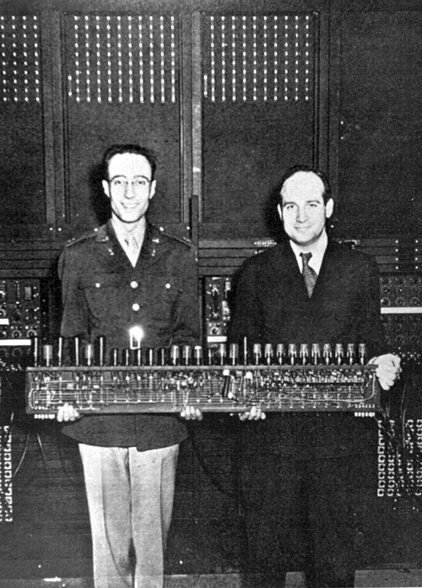
Artillery and vacuum tubes
ENIAC (Electronic Numerical Integrator And Computer)
  Artillery and bombing tables took too long
  Military hired Dr. Presper Eckert and Dr. John Mauchly for a solution
  Began in 1943, announced in 1946, cost $500,000, weighed roughly 30 tons, required 18k vacuum tubes!
  Was thought impossible, too unreliable
  Programmed by wire…

Slide 10
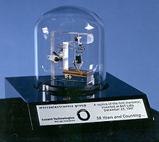
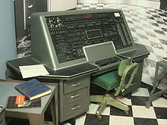
Transistors and the UNIVAC
Transistors came about from research at AT&T’s Bell Labs and was the work of Berdeen, Brattain, and Shockley
was a smaller, faster, safer, cheaper and more reliable version of the vacuum tube
1950’s census is taking too long, the census needs help again
Hires the makers of the ENIAC to take advantage of the transistor.
The result is the UNIVAC I, which predicts the 1952 presidential election, shocking all with Eisenhower’s victory

Slide 11
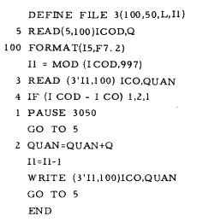
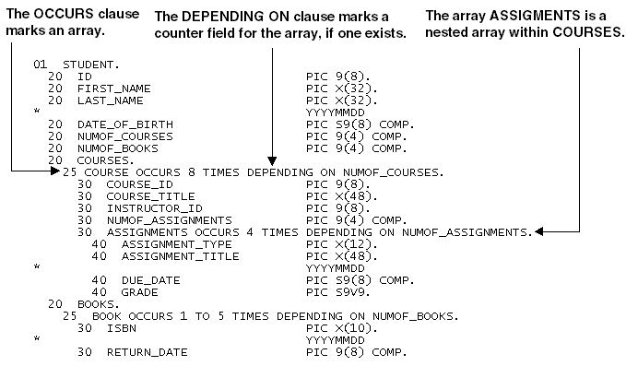
Languages!
With the success of the UNIVAC and other large computers, more people are taking advantage of them.
Programming these computers is tough stuff… either it’s binay or assembly coding
FORTRAM (Formula Translation) (John Backus, 1954) comes about the help mathematicians. One of the first “high level” languages
COBOL (Common Business-oriented Language) ( Grace Hopper 1959) comes about to help businesses program.

Slide 12
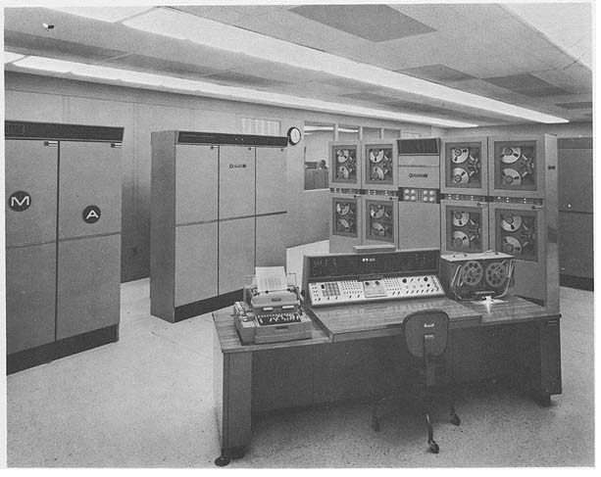
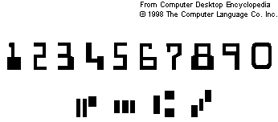
ERMA and MICr
1955, Bank of America announces it’s latest project with the Stanford Research Institute: ERMA the Electronic Record Method of Accounting
Seeks to revolutionize the banking industry with raw computing power
ERMA comes equipped with MICR (Magnetic Ink Character Recognition) allows computers to read checks and changes the consumer experience forever.

Slide 13
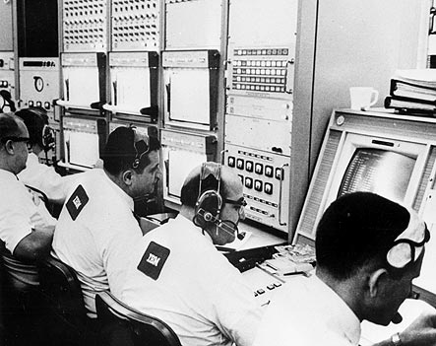
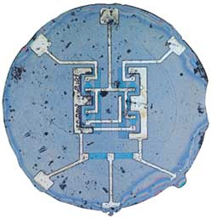
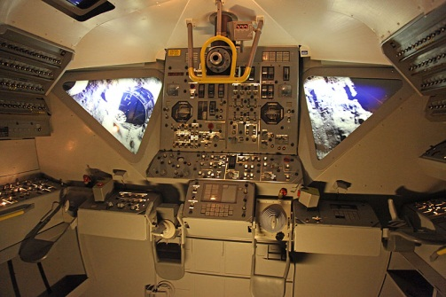
Integrated circuits and the space race
The “Tyranny of Numbers”
Seeking to miniaturize transistors, Jock Kilby and Robert Noyce separately come upon the Integrated circuit
Combines transistors, resistors, capacitors, and all the wiring onto a single chip of semiconductor material
Smaller, safer, faster, more reliable, easier to make, but more expensive
Wasn’t until the manned mission to the moon that they were put into use on a large scale (1960ish)

Slide 14
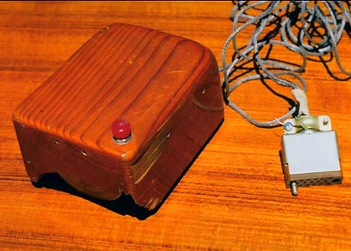
Of Mice and folders
Much like computer programming, computer interfaces are designed for and by a specialized group. All interaction is either physical or text.
A wider group of individuals were using computers (they were getting smaller and more prevalent), they required a very specific skill sets to use.
Machine interaction becomes a field of study
Doug Engelbart invents mouse, uses it in conjunction with one of the first GUI’s (1964)
Not the first interactive tool, but one that stuck around along with the “office” metaphor (files, folders, projects, desktops)

Slide 15
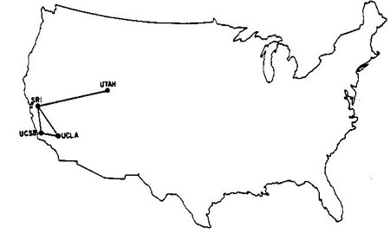
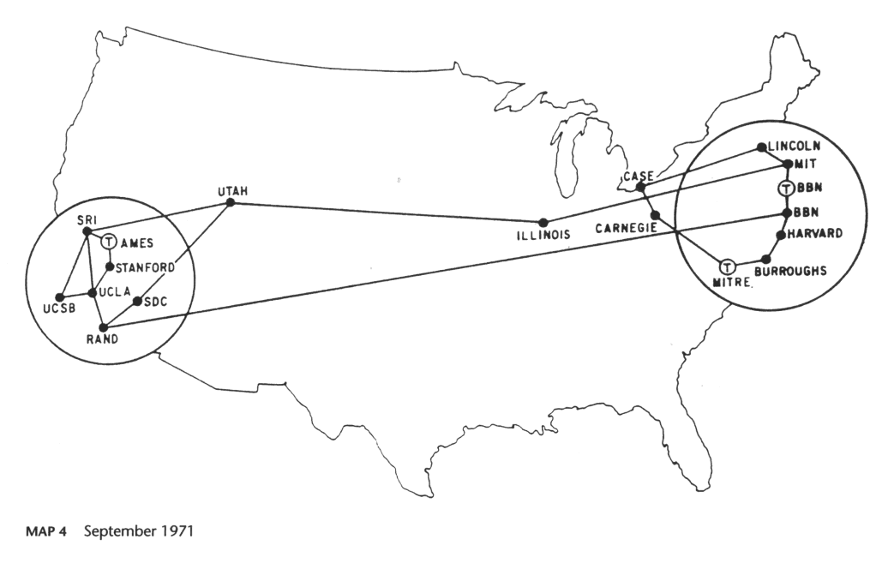
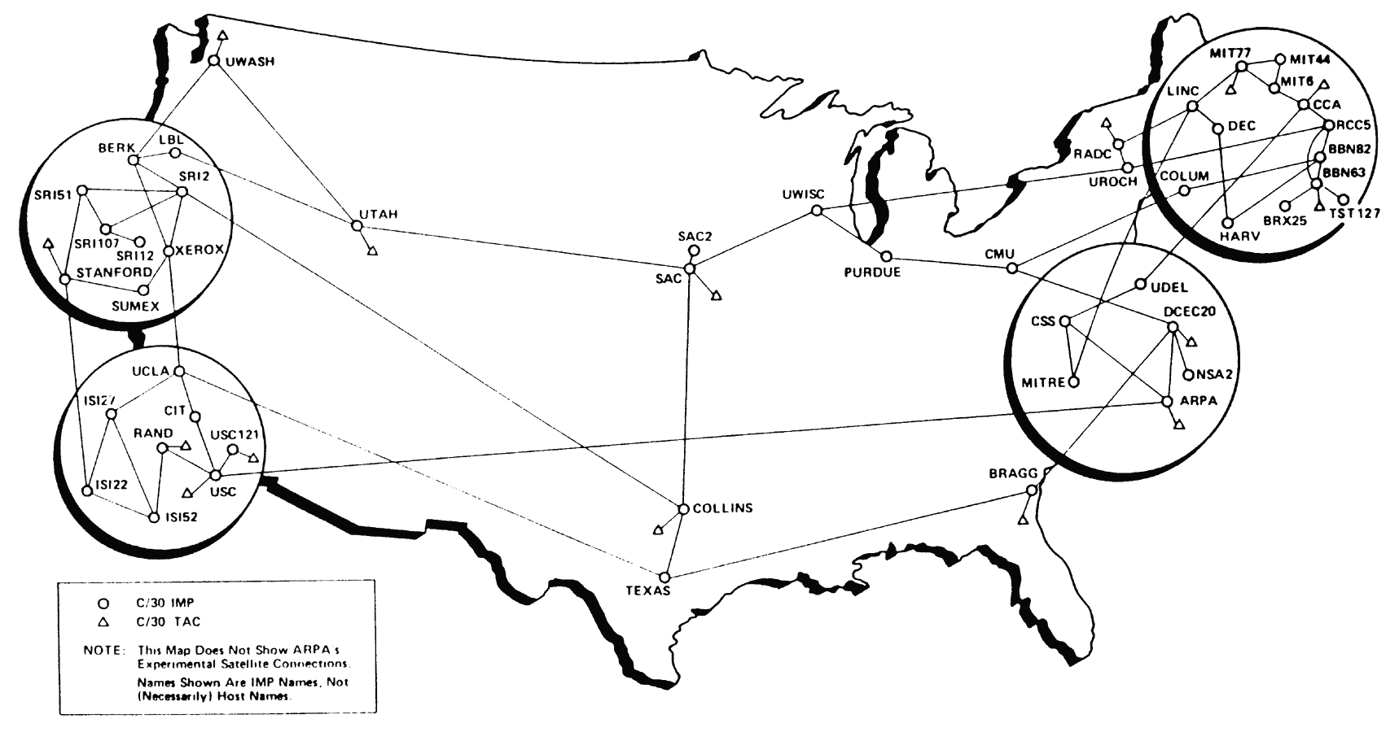
The internet and global thermonuclear war
1969 ARPAnet, links computers with a standard protocol for the flow of information.
Started with 4 university computers, grew quickly in both size and structure
Innovations included: email, telnet (remote computing), and FTP (file transfer protocol).
As it became larger, became unsafe for strictly military applications (MILnet)
Spawned Local Area Networks (LAN’s)
NSFnet (National Science Foundation network) starts as a LAN, branches out to connect other LAN’s (1986), starts to replace ARPAnet (closed 1990) for universities, evolves into the current internet.

Slide 16
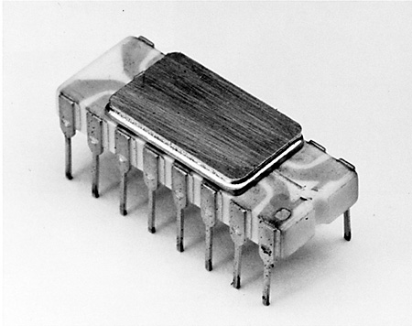
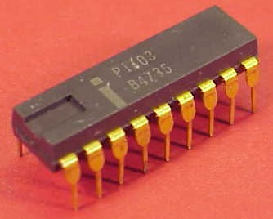
Ramming speed! And microprocessors
The integrated circuit improves processing speed so much that memory speed (especially for non-sequential memory) becomes an issue.
In 1970, Intel comes out with the first Dynamic Random Access Memory (DRAM)
RAM had been around since 1947, this makes it smaller and faster, mass marketed.
1969-1971 Fredrico Faggin at Intel designs the first microprocessor, thus completing all of the hardware components necessary for the personal computer

Slide 17
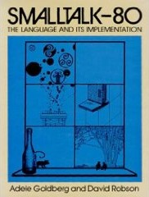
Smalltalk and objects
1960’s and 70’s saw the rise of many new programming languages including BASIC, C (what comes after B), Pascal, and Smalltalk
Smalltalk is one of the most influential object oriented languages, based on the ideas of encapsulation, message passing, and modular programming.
Revolutionized how computer programs were written.
Notes:
Advances in the production and writing of code allows for more software to be available,

Slide 18
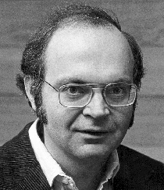
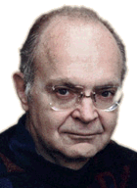
Donald Knuth
Often called the “Father of Computer Science”
As a child he won an anagram competition for “Ziegler's Giant Bar”, finding over 4,500 words that could be made out of those letters (2,000 more than the judges of the competition had found)
Barely chose physics over music as a major at Case Institute of Technology
Wrote: “The Art of Computer Programming” a guide to programming algorithms and their analysis that helped set computer science apart form other disciplines.
Notes:
More abstraction. One of the final layers that was added to complete enough of a hci illusion to allow a home computer audience.

